Slide 1
Code Coverage and Continuous Integration
Presented at Better Scientific Software tutorial
ECP 2nd Annual Meeting, Knoxville, Tennessee
Jared O’Neal Argonne National Laboratory

Slide 2
License, citation and acknowledgements
License and Citation
This work is licensed under a Creative Commons Attribution 4.0 International License (CC BY 4.0).
Requested citation: Jared O'Neal, Code Coverage and Continuous Integration, tutorial in Exascale Computing Project 2nd Annual Meeting, Knoxville, Tennessee, 2018. DOI: TBA.
Acknowledgements
Alicia Klinvex
This work was supported by the U.S. Department of Energy Office of Science, Office of Advanced Scientific Computing Research (ASCR), and by the Exascale Computing Project (17-SC-20-SC), a collaborative effort of the U.S. Department of Energy Office of Science and the National Nuclear Security Administration.
This work was performed in part at the Argonne National Laboratory, which is managed by UChicago Argonne, LLC for the U.S. Department of Energy under Contract No. DE-AC02-06CH11357.
Notes:
Thank Alicia Klinvex again since these slides and the talk are built off of her efforts.

Slide 3
Code Coverage

Slide 4
How do we determine what other tests are needed?
Code coverage tools
Expose parts of the code that aren’t being tested
gcov
standard utility with the GNU compiler collection suite
compile with --coverage
counts the number of times each statement is executed
lcov
a graphical front-end for gcov
available at http://ltp.sourceforge.net/coverage/lcov.php
Hosted servers (e.g. coveralls, codecov)
graphical visualization of results
push results to server through continuous integration server

Slide 5
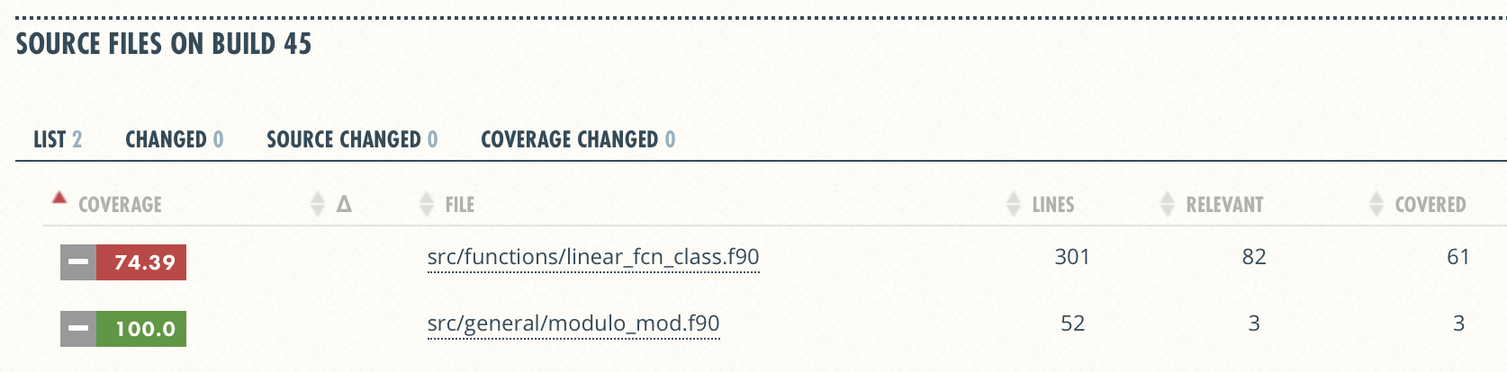
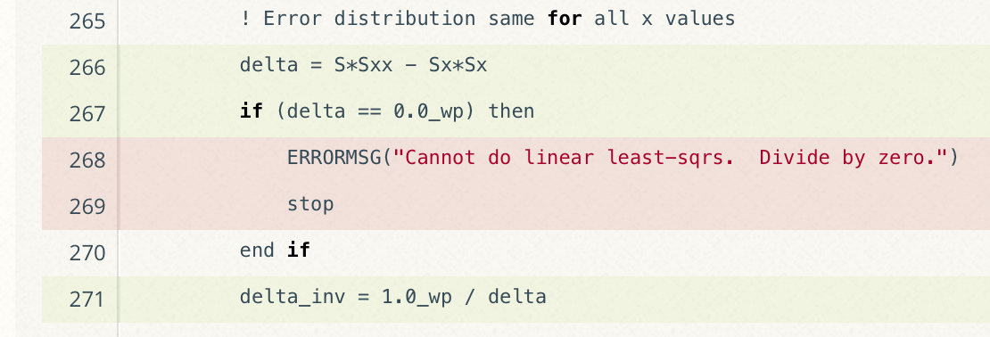
Code coverage output
Overall Analysis
Detailed Analysis
Online tutorial - https://github.com/amklinv/morpheus
Other example - https://github.com/jrdoneal/infrastructure
Notes:
Missing testing of edge cases. This might be important!

Slide 6
Code coverage is popular
gcov also works for C and Fortran
Other tools exist for other languages
JCov for Java
Coverage.py for python
Devel::Cover for perl
profile for MATLAB
etc.

Slide 7
Continuous integration

Slide 8
The Short & Sweet of Continuous Integration
A master branch that always works
Develop workflow policies
Commit and merge often
Test on push & pull requests?
Code changes trigger automated builds/tests on target environments

Slide 9
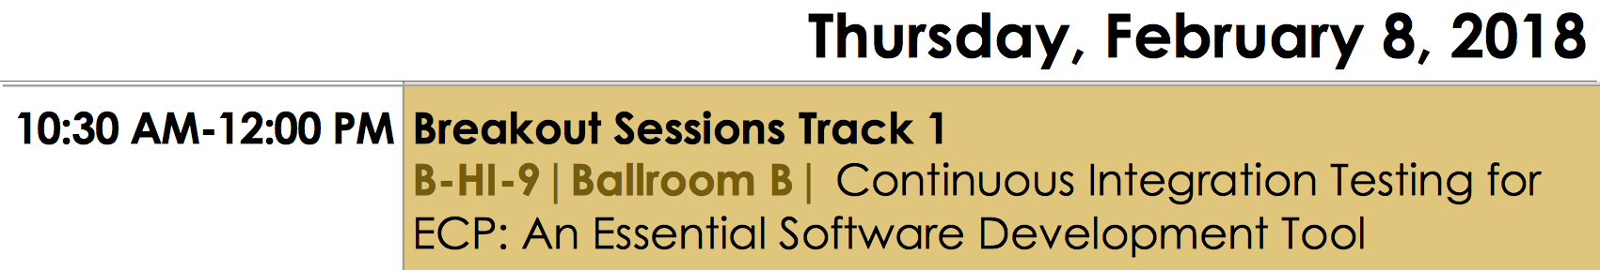
Continuous integration (CI)
Has existed for some time and interest is growing
ECP working with Travis CI to adapt for HPC machines
Dedicated Breakout Session
Setup, maintenance, and monitoring required
Prerequisites
A reasonably automated build system
An automated test system with significant test coverage & useful feedback
Ability to bundle subset of tests
Builds/tests must finish in reasonable about of time

Slide 10
Cloud-based CI
Linked to VCS hosts
GitHub & Travis CI
GitLab CI
BitBucket Pipelines
Automated builds/tests triggered via pushes and pull requests
Builds/tests can be run on cloud systems
Test results are reported on the pull request page
Can trigger code coverage analysis & documentation build
Run tests on different environments
Notes:
No need to build and maintain a dedicated server.

Slide 11
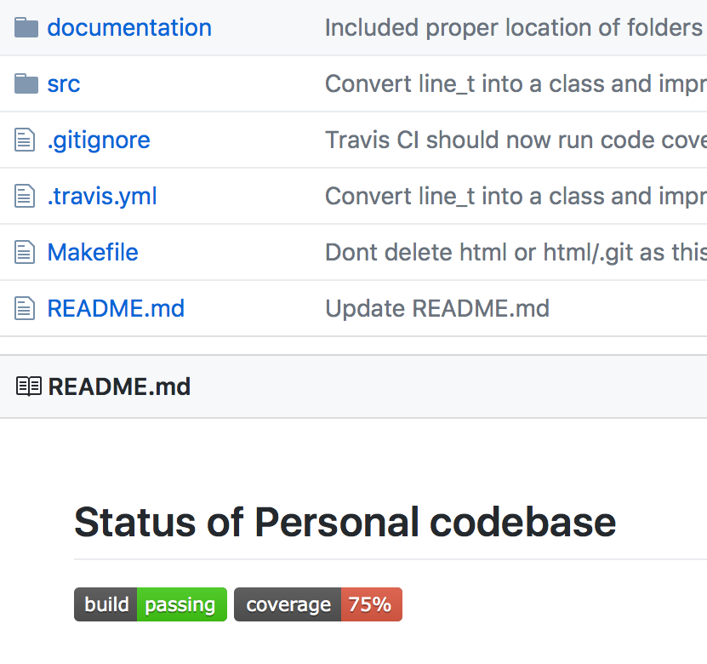
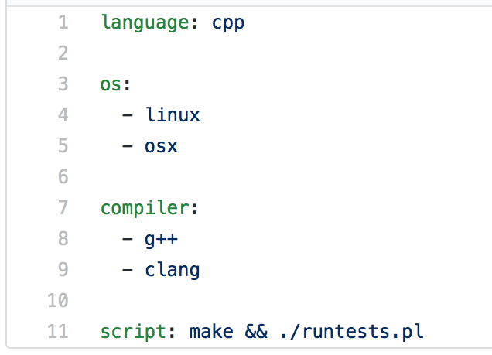
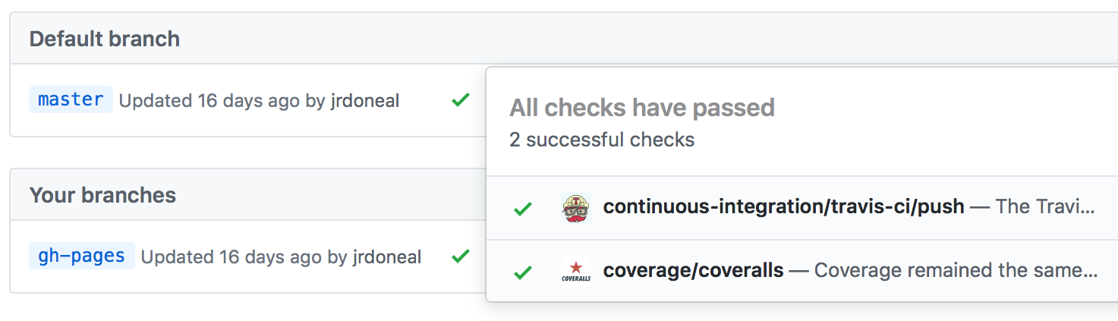
View of toy repository
https://github.com/jrdoneal/infrastructure
Repository Root
Sample .travis.yml
Results of CI Actions
Updated automatically
Notes:
Good online documentation and there are plenty of working examples in GitHub itself.

Slide 12
Putting it all together
Toy CI Workflow
Notes:
Many projects have an intermediate branch such as development that first test on.

Slide 13
Other resources
Software testing levels and definitions:
http://www.tutorialspoint.com/software_testing/software_testing_levels.htm
Working Effectively with Legacy Code, Michael Feathers. The legacy software change algorithm described in this book is very straight-forward and powerful for anyone working on a code that has insufficient testing.
Code Complete, Steve McConnell. Includes testing advice.
Organization dedicated to software testing: https://www.associationforsoftwaretesting.org/
Software Carpentry: http://katyhuff.github.io/python-testing/
Tutorial from Udacity: https://www.udacity.com/course/software-testing--cs258
Papers on testing:
http://www.sciencedirect.com/science/article/pii/S0950584914001232
https://www.researchgate.net/publication/264697060_Ongoing_verification_of_a_multiphysics_community_code_FLASH
Resources for Trilinos testing:
Trilinos testing policy: https://github.com/trilinos/Trilinos/wiki/Trilinos-Testing-Policy
Trilinos test harness: https://github.com/trilinos/Trilinos/wiki/Policies--%7C-Testing

Slide 14
Agenda
Time | Topic | Speaker
1:30pm-2:15pm | Why effective software practices are essential for CSE projects | Anshu Dubey, ANL
2:15pm-2:45pm | Better (small) scientific software teams | Michael A. Heroux, SNL
2:45pm-3:00pm | Improving Reproducibility Through Better Software Practices | Michael A. Heroux, SNL
3:00pm-3:30pm | Break
3:30pm-4:15pm | Testing HPC Scientific Software: Introduction | Jared O’Neal, ANL
4:15pm-4:45pm | Verification, and Evaluating Project Testing Needs | Anshu Dubey, ANL
4:45am-5:00pm | Code Coverage and CI | Jared O’Neal, ANL

